Slide 1
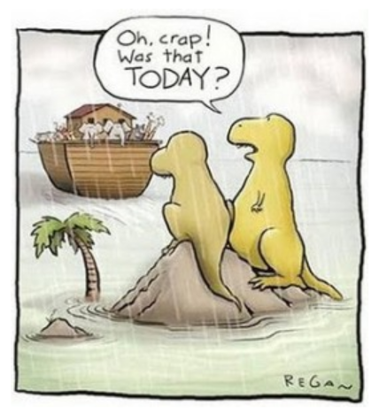
Extinction

Slide 2
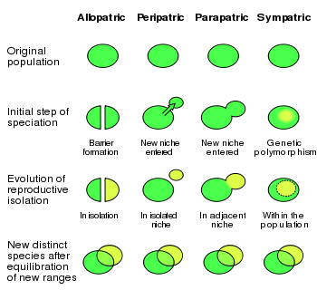
SPECIATION

Slide 3
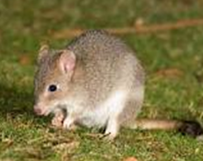

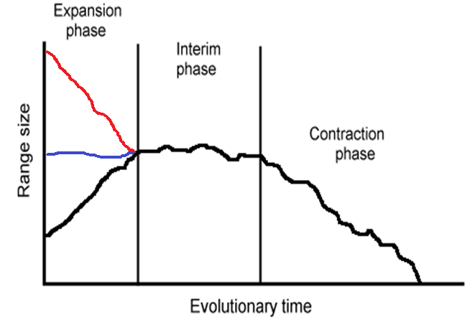


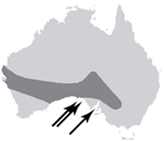
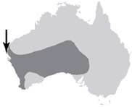
How species go extinct?
Outward
Inward
Why will this be important?
Allopatric
How does it occur?
Sympatric
Of 245 species analyzed, 98% maintained populations in at least a portion of their peripheral range before going extinct (Channell & Lomolino, Nature 2000)
Peripatric
Extinction: lost of the last individual of a species

Slide 4

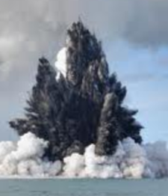
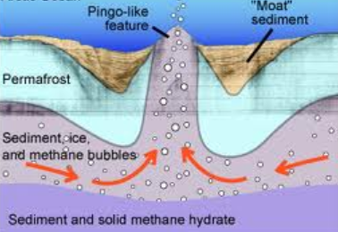
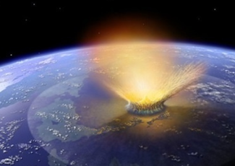
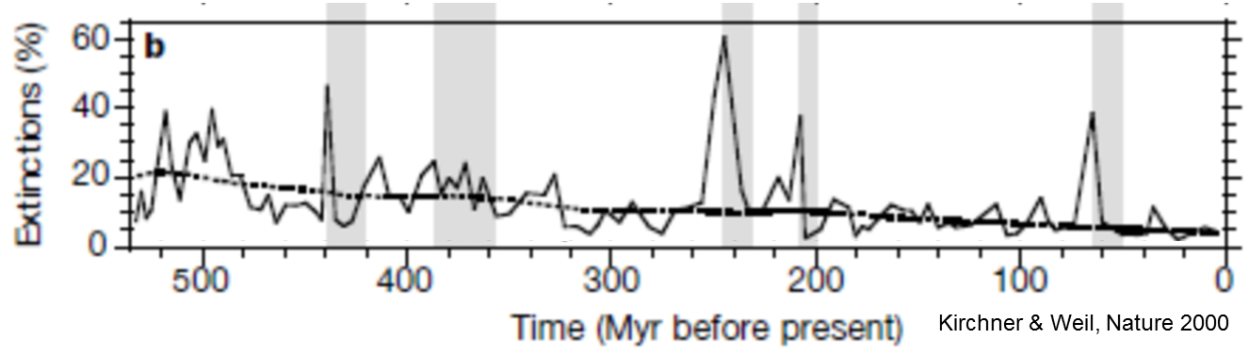
Some facts about extinction
0.1% extant
Glaciation
Volcanism
Methane
Meteorites
99.9% extinct
Of all species that have existed on Earth, 99.9% are now extinct.
?
The causes of extinction events have been controversial mostly because we lack evidence.
Over the past half billion years, there have been at least twenty mass extinctions. Five of these were major—the so-called Big Five
Notes:
he clathrate gun hypothesis is the popular name given to the hypothesis that rises in sea temperatures (and/or falls in sea level) can trigger the sudden release of methane from methane clathrate compounds buried in seabeds and permafrost which, because the methane itself is a powerful greenhouse gas, leads to further temperature rise and further methane clathrate destabilization – in effect initiating a runaway process as irreversible, once started, as the firing of a gun

Slide 5
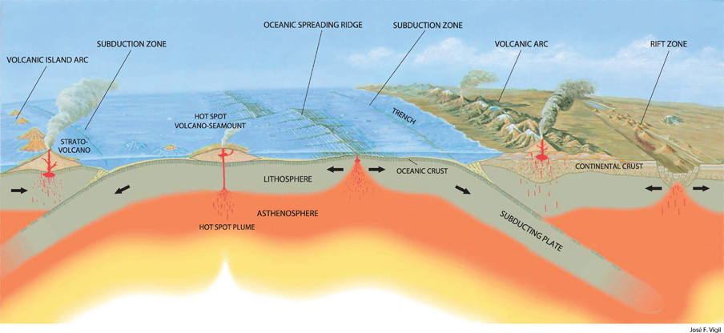
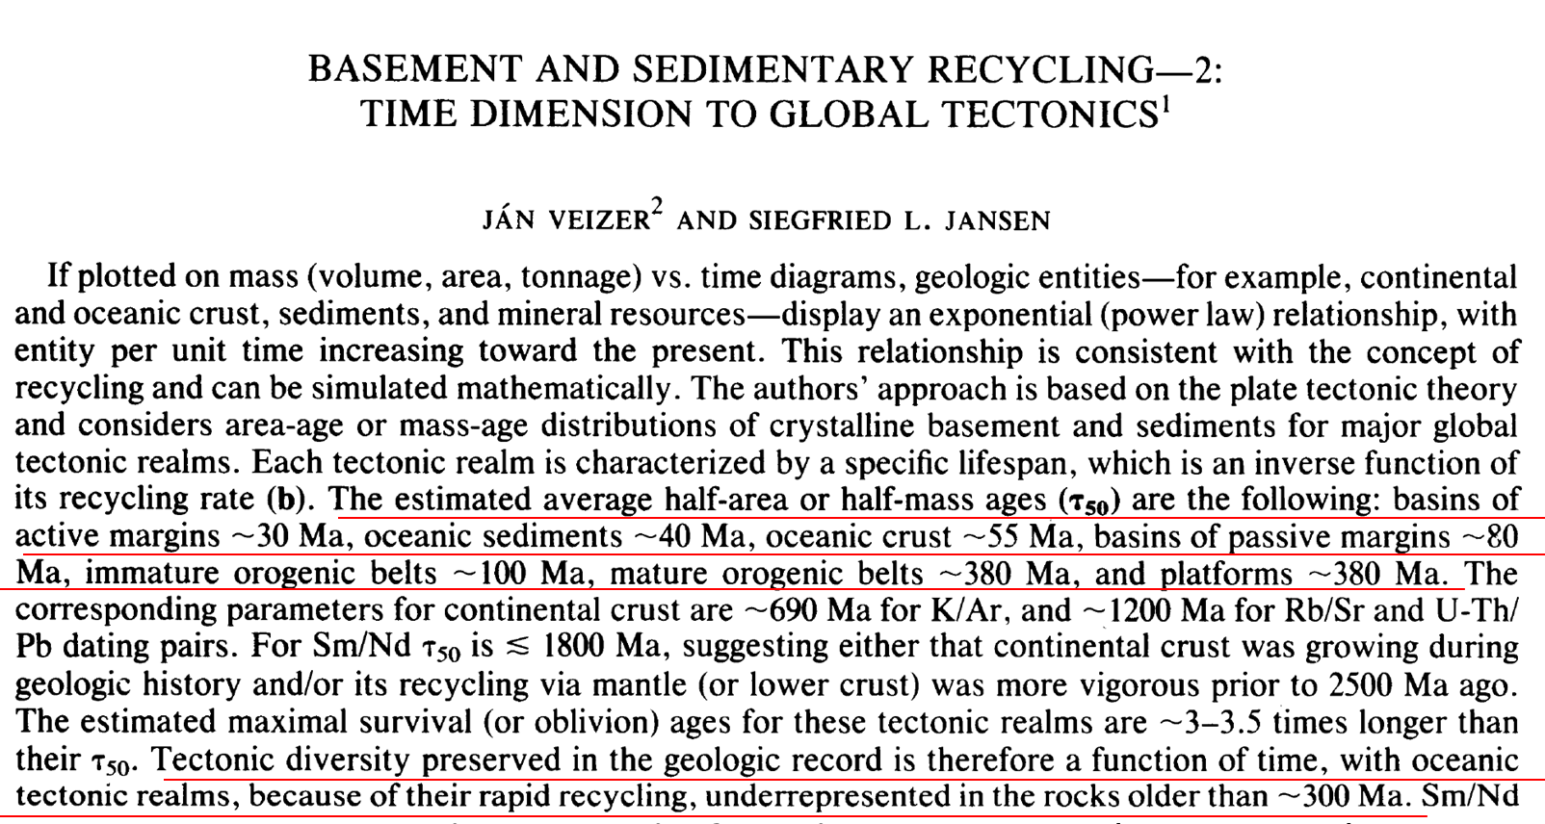
Why a lack of evidence: recycling of fossils due to plate tectonics.
The Journal of Geology 93, no. 6 (Nov., 1985): 625-643.

Slide 6
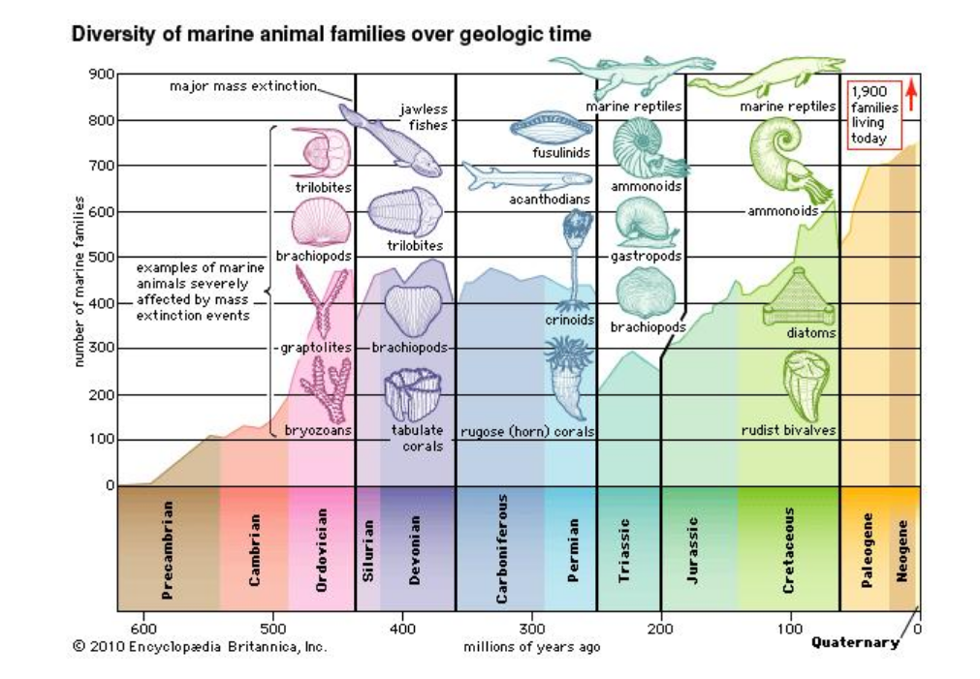
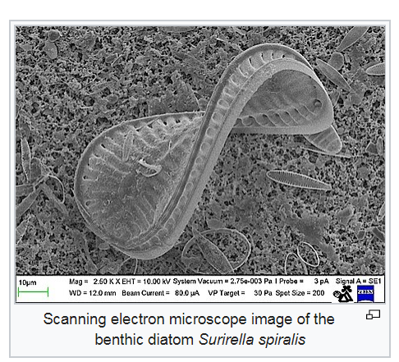
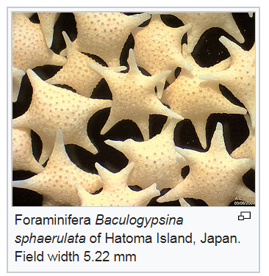
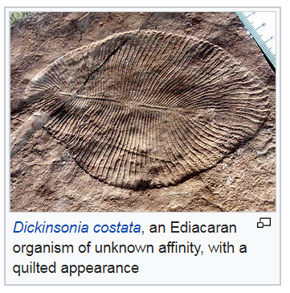
Additional explanation :species capable of leaving fossil only emerged recently
Cambrian explosion
Diatoms
Forams

Slide 7
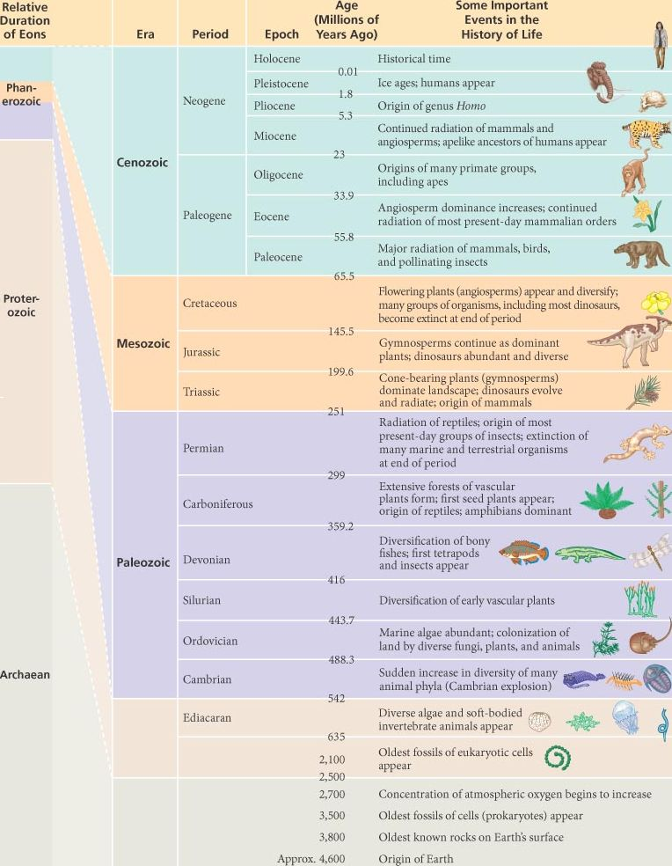
So why of fossil record is low?: likely a combination of crust turnover and recent evolution of fossil “leaving” species.

Slide 8
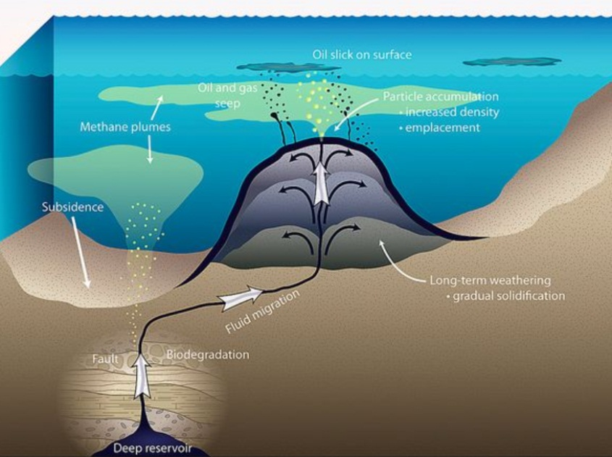
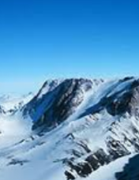
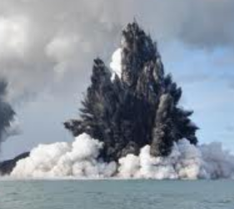
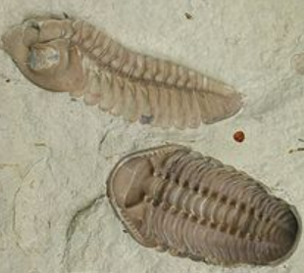

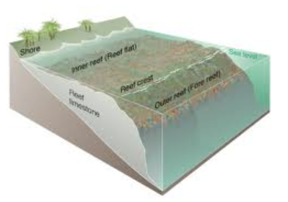
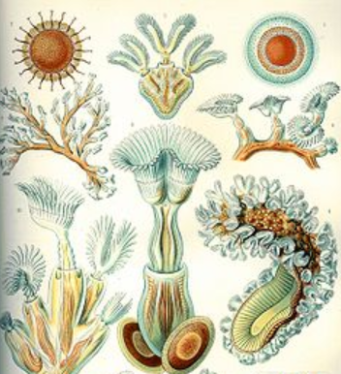
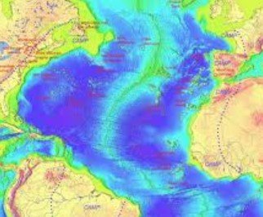
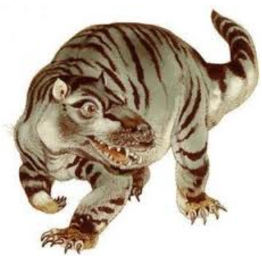
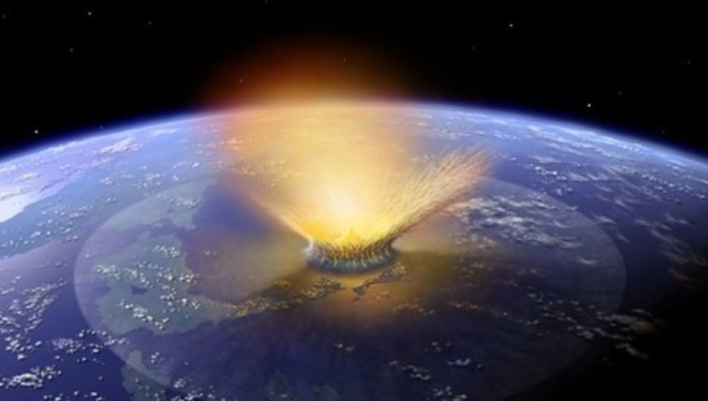
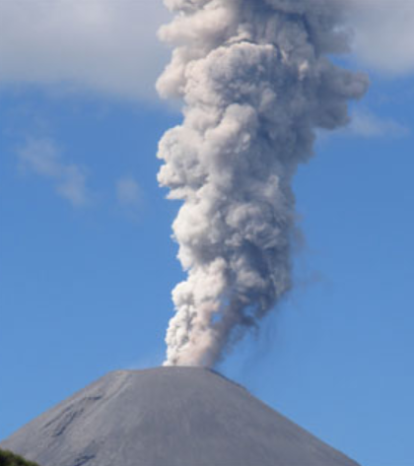
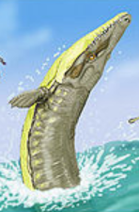
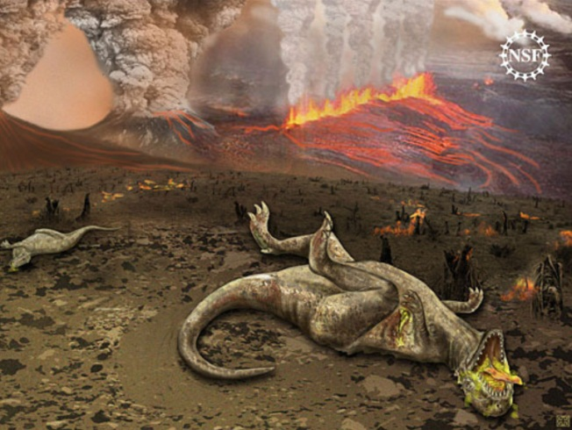
The Big Five
Ocean anoxia, possibly triggered by global cooling or oceanic volcanism, among main suggested causes
Sea level and glacially-driven cooling among suggested causes of this extinction event
Ordovician–Silurian event, the second largest of the five major extinctions on Earth, more than 60% of marine invertebrates died including brachiopods, bivalves, echinoderms, bryozoans and corals.
Late Devonian, ~ 70% of all species at the time went extinct, the event was more catastrophic in the ocean and included trilobites and coral-like organisms.
Permian–Triassic event, "Great Dying“, ~96% of all marine species and ~ 70% of land species at the time went extinct including large mammal-like reptiles and most insects
Triassic–Jurassic event, at least half of the species at that time went extinct including the large amphibians and some reptiles crocodile-like
End-Cretaceous event, seventy-five per cent of all species on earth were exterminated including the dinosaurs

Slide 9
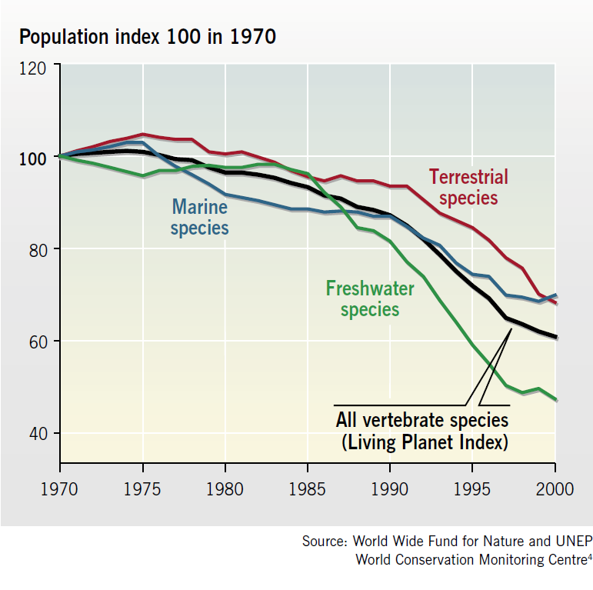
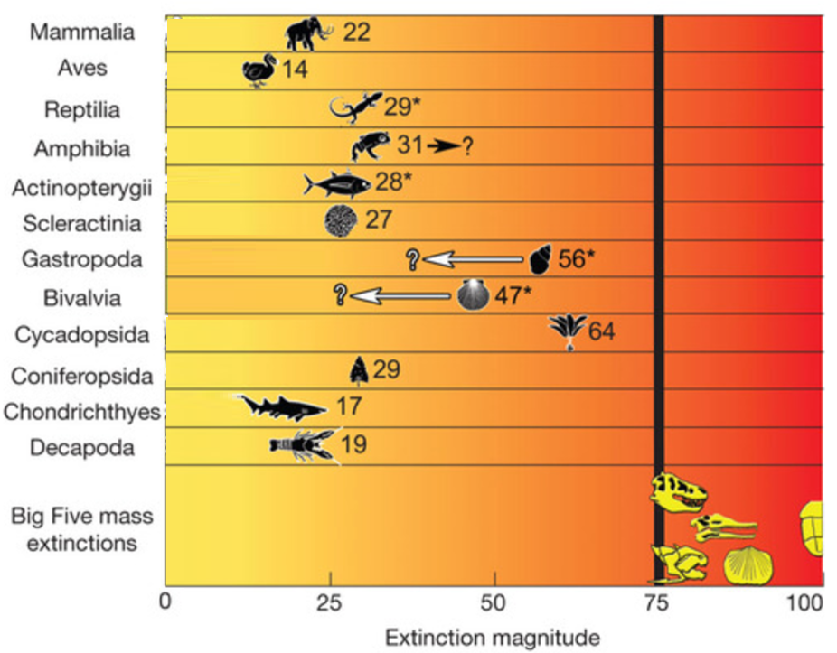
Are we in the verge of the sixth mass extinction?
Only 1 to 2 percent of all species have gone extinct in recent decades
'endangered' and 'vulnerable' categories
‘critically endangered’
However
2100
2050
Barnosky et al., Nature 2011

Slide 10
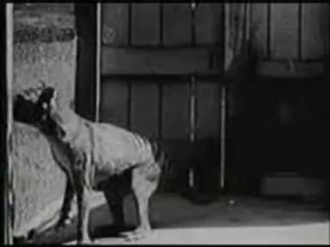
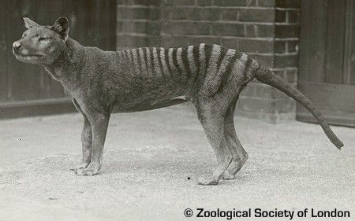
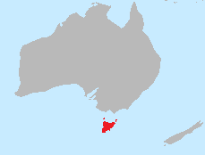
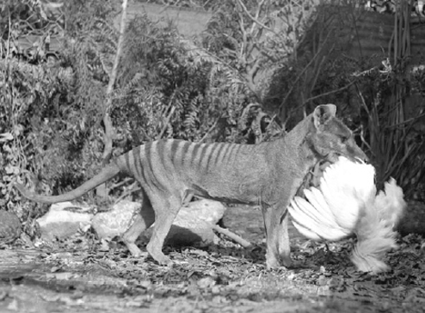
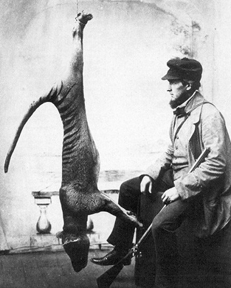
A tail of extinctions: Tasmanian Tiger (Thylacinus cynocephalus)
The Thylacine, and its decedents, were around for about 4 million years
The last known wild Thylacine was shot and killed in 1930
It was the largest carnivorous marsupial of recent times, was abundant and broadly distributed in Tasmania till about 1800’s
The last known living Thylacine (in captivity in the Hobart Zoo) died September 7th 1936
Tasmanian law was introduced in 1936 to protect the Tasmanian tiger
Livestock killer
Wiped out by man in less than 200 years

Slide 11
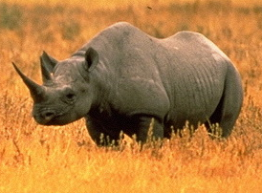

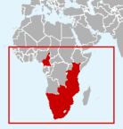
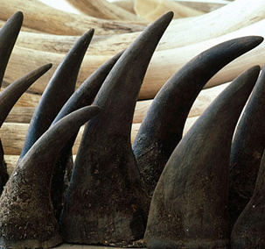
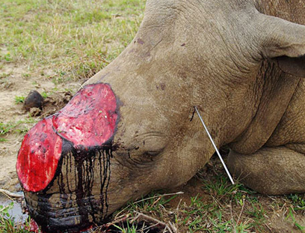
A tail of extinctions: Western Black Rhino (Diceros bicornis longipes)
The Western Black Rhino roamed the planet for the last 50 Mio yrs
There have not been any reports of any sightings or signs since 2006
By 1960, there were more than 100,000 individuals in the wild in Africa
Supposedly a medicine asset. On the streets a kilogram is ~$65,000, more expensive than gold, platinum and in many cases cocaine..."
Declared extinct in the wild in 2011
Wiped out by man in less than 40 years

Slide 12
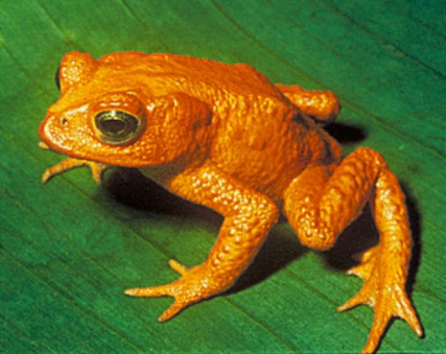
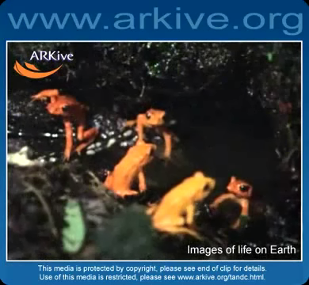
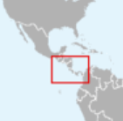
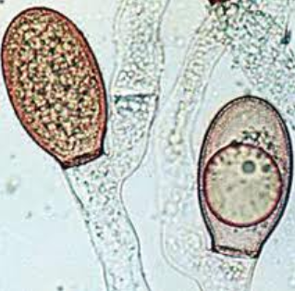
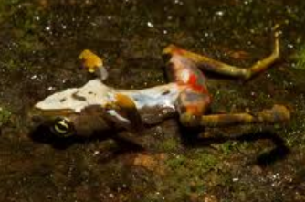
A tail of extinctions: Golden toad (Bufo periglenes )
Croaking in South American forest for the last 65 million years
No golden toads have been seen since 1989
In 1987, more than 1500 golden toads were observed during the breeding period
Climatic change, pollution, ultraviolet radiation, and fungal skin infections
Declared extinct in 1992
Wiped out in less than 30 years

Slide 13
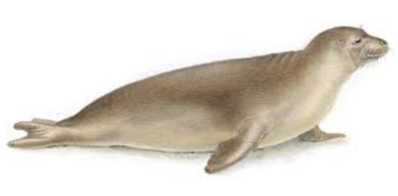
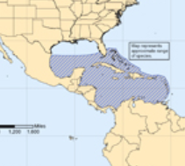
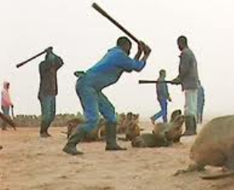
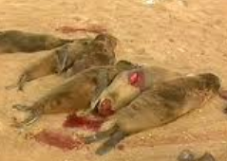
A tail of extinctions: Caribbean Monk Seal (Monachus tropicalis)
Discovered during Christopher Columbus' second voyage to the New World in 1494. Population estimated at 250.000 individuals
The last confirmed sighting in 1952, protected by law in 1967, declared extinct in 2008
Killed mainly for their blubber, which was processed into oils, used for lubrication, and applied as a coating on the bottom of boats
Wiped out in less than 300 years

Slide 14
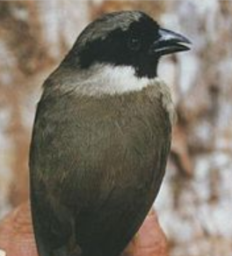
















Few others no longer with us…
Puhielelu Hibiscadelphus
Hawaiian Honeycreeper
Black Spotted Damselfish
Liverpool Pigeon
Angel shark
Bezule
Caspian tiger
Atitlán Grebe
Eastern Cougar
Extinct 1981
Extinct 2004
Extinct 1970
Extinct 2008
Alaotra Grebe
Extinct 2011
Extinct 1930
The Quagga
Steller's Sea Cow
Great Auk
Pyrenean Ibex
Extinct 1970
St. Helena Olive
Extinct 1989
Cape Lion
Blue walleye
Extinct 2011
Extinct 2010
Extinct 1900s
Extinct 1741
Extinct 1840
Extinct 2000
Extinct 1963
Extinct 2003
Extinct 1983

Slide 15

Challenges to determine an extinction
Proving that any individual species has gone extinct demands long, fruitless searching
Yangtze River dolphin
(Lipotes vexillifer)
Last sighting in 2002
Almost declare extinct in 2006 after an acoustic and visual survey of the river turned up nothing. Then, a blurry video gave experts pause, and it was rated "possibly extinct."
There is not confirmation of complete extinction yet

Slide 16



So when do we declare a species extinct?
Raphus cucullatus (Dodo)
Mauritius
The last confirmed sighting was 1662
BUT
when a species becomes increasingly rare before its final extinction, it may continue to exist unseen for many years — so the time of its last sighting may be a poor estimate of the time of extinction.
Latest sights
1598,
1601,
1602
1607,
1611,
1628,
1631,
1638,
1662
1690
Roberts & Solow, Nature 2003

Slide 17



So when do we declare a species extinct?
Probability of extinction, (Dulvy et al. Fish & Fisheries 2004)
n: the number of time intervals in which the species was observed
T: the total number of intervals sampled
tc: the total number of intervals sampled up to the time the species was last observed
T= 1994-1964 = 31
n = 9 years
tc = 25
The last sturgeon was recorded in the 25rd year of the record span
The probabilities that sturgeon is locally extinct from the James River is 0.856

Slide 18

So when do we declare a species extinct?
Time to extinction (Ward-Paige et al., PlosOne 2010)
Whenever a population is expected to reach zero density

Slide 19

How hard is to recover from extinction?
end-Triassic
End-Ordovician
Cretaceous-Tertiary
Kirchner & Weil, Nature 2000
The historical record suggest that on average recovering from an extinction event takes up to 10 million years….
…so…
….today's anthropogenic extinctions will diminish biodiversity for millions of years to come (Kirchner & Weil, Nature 2000)

Slide 20










Eastern Island: a tail about the consequences of extinction
Colonized by Polynesians any where between 300 and 1200 CE
21 species of trees and multiple species of land birds existed at the time
Most land species went extinct
Land species used excessively
No wood for boats
…no fishing
…no scape
No food
Cannibalism
Species were harvested faster than they could be replenished
Notes:
But there is another twist to the story

Slide 21
Extinction is seriously forever

